Slide 1
Cookie and Session

Slide 2
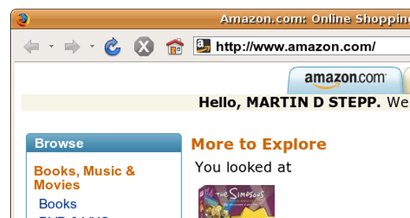
Stateful Client/Server Interaction
Sites like amazon.com seem to "know who I am." How do they do this?
HTTP is a stateless protocol; it simply allows a browser to request a single document from a web server
Cookies are used to work around this problem, which are used as the basis of higher level sessions between clients and servers

Slide 3
What is a cookie?
cookie: a small amount of information sent by a server to a browser, and then sent back by the browser on future page requests
cookies have many uses:
authentication
user tracking
maintaining user preferences, shopping carts, etc.
a cookie's data consists of a single name/value pair, sent in the header of the client's HTTP GET or POST request

Slide 4
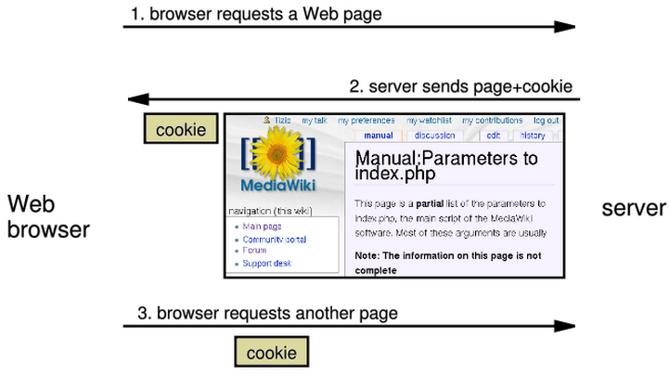
How cookie are sent
when the browser requests a page, the server may send back a cookie(s) with it
if your server has previously sent any cookies to the browser, the browser will send them back on subsequent requests
alternate model: client-side JavaScript code can set/get cookies

Slide 5
Myths about cookies
Myths:
Cookies are like worms/viruses and can erase data from the user's hard disk.
Cookies are a form of spyware and can steal your personal information.
Cookies generate popups and spam.
Cookies are only used for advertising.
Facts:
Cookies are only data, not program code.
Cookies cannot erase or read information from the user's computer.
Cookies are usually anonymous (do not contain personal information).
Cookies CAN be used to track your viewing habits on a particular site.

Slide 6
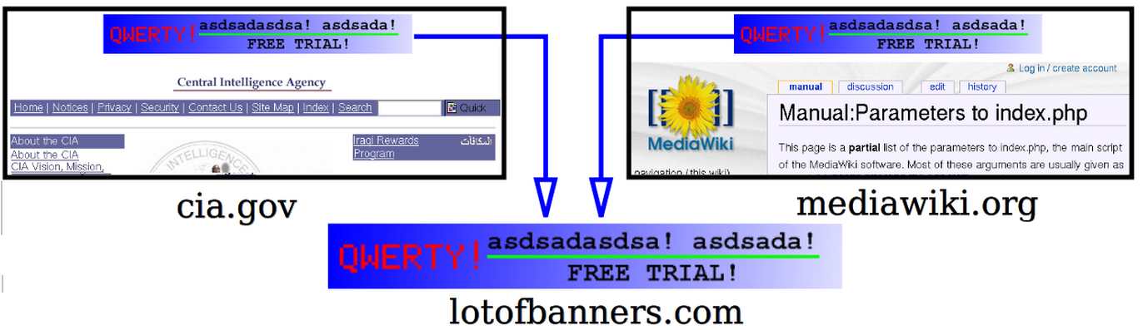
A “tracking cookie”
an advertising company can put a cookie on your machine when you visit one site, and see it when you visit another site that also uses that advertising company
therefore they can tell that the same person (you) visited both sites
can be thwarted by telling your browser not to accept "third-party cookies"

Slide 7
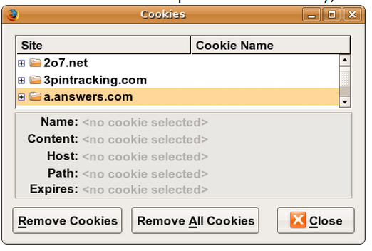
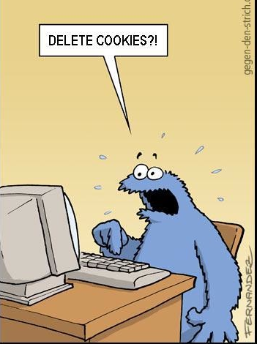
Where are the cookies on my computer?
IE: HomeDirectory\Cookies
e.g. C:\Documents and Settings\jsmith\Cookies
each is stored as a .txt file similar to the site's domain name
Chrome: C:\Users\username\AppData\Local\Google\Chrome\User Data\Default
Firefox: HomeDirectory\.mozilla\firefox\???.default\cookies.txt
view cookies in Firefox preferences: Privacy, Show Cookies...

Slide 8
How long does a cookie exist?
session cookie : the default type; a temporary cookie that is stored only in the browser's memory
when the browser is closed, temporary cookies will be erased
can not be used for tracking long-term information
safer, because no programs other than the browser can access them
persistent cookie : one that is stored in a file on the browser's computer
can track long-term information
potentially less secure, because users (or programs they run) can open cookie files, see/change the cookie values, etc.

Slide 9
Create Cookie using JavaScript
Cookies let you store user information in web pages.
JavaScript cookies are stored in small text files on your computer.
Cookies are saved in name-value pairs like: username=John Doe
When a browser request a web page from a server, cookies belonging to the page is added to the request. This way the server gets the necessary data to "remember" information about users.

Slide 10
Create and Read Cookie
With JavaScript, a cookie can be created like this:
document.cookie="username=John Doe";
You can also add an expiry date (in UTC or GMT time). By default, the cookie is deleted when the browser is closed:
document.cookie="username=John Doe; expires=Thu, 18 Dec 2023 12:00:00 GMT";
With JavaScript, cookies can be read like this:
document.cookie=“name=john; expires=Thu, 18 Dec 2023 12:00:00 GMT”;
document.cookie=“visits=2”; expires=Thu, 18 Dec 2023 12:00:00 GMT”
document.write(document.cookie);
// document.cookie will return all cookies in one string: name=john; visits=2;

Slide 11
Cookie in JavaScript
document.cookie = "username=smith"; // setting two cookies
document.cookie = "password=12345";
document.cookie = "age=29;
expires=Thu, 01-Jan-1970 00:00:01 GMT"; // deleting a cookie ...
// (later)
var allCookies = document.cookie.split(";");
// ["username=smith", "password=12345"]
for (var i = 0; i < allCookies.length; i++) {
var eachCookie = allCookies[i].split("="); // ["username", "smith"]
var cookieName = eachCookie[0]; // "username"
var cookieValue = eachCookie[1]; // "smith"
...
}
JS has a global document.cookie field (a string)
you can manually set/get cookie data from this field (separated by ;), and it will be saved in the browser
to delete a cookie, set it to 'expire' in the past

Slide 12
JavaScript Cookie Example
In the example to follow, we will create a cookie that stores the name of a visitor.
The first time a visitor arrives to the web page, he will be asked to fill in his name. The name is then stored in a cookie.
The next time the visitor arrives at the same page, he will get a welcome message.
For the example (complete code) we will create 3 JavaScript functions:
A function to check a cookie value
A function to set a cookie value
A function to get a cookie value

Slide 13
A Function to Check a Cookie
function checkCookie(){ var username=getCookie("username"); if (username!=""){ alert("Welcome again " + username);
} else { username = prompt("Please enter your name:",""); if (username!="" && username!=null){ setCookie("username",username,365); } } }
Explanation
If the cookie is set it will display a greeting.
If the cookie is not set, it will display a prompt box, asking for the name of the user, and stores the username cookie for 365 days, by calling the setCookie function:

Slide 14
A Function to Set a Cookie
function setCookie(cname,cvalue,exdays){ var d = new Date(); d.setTime(d.getTime()+(exdays*24*60*60*1000)); var expires = "expires="+d.toGMTString(); document.cookie = cname + "=" + cvalue + "; " + expires; }
Example explained:
The parameters of the function above are the name of the cookie (cname), the value of the cookie (cvalue), and the number of days until the cookie should expire (exdays).
The function sets a cookie by adding together the cookiename, the cookie value, and the expires string.

Slide 15
A Function to Get a Cookie
function getCookie(cname){ var name = cname + "="; var ca = document.cookie.split(';'); for(var i=0; i<ca.length; i++) { var c = ca[i].trim(); if (c.indexOf(name)==0) return c.substring(name.length,c.length); } return ""; }
Function explained:
Take the cookiename as parameter (cname).
Create a variable (name) with the text to search for (cname + "=").
Split document.cookie on semicolons into an array called ca (ca = document.cookie.split(';')).
Loop through the ca array (i=0;i<ca.length;i++), and read out each value trimmed (c=ca[i].trim()).
If the cookie is found (c.indexOf(name) == 0), return the value of the cookie (c.substring(name.length,c.length).
If the cookie is not found, return "".

Slide 16
How to create a cookie in PHP?
The setcookie() function is used to set a cookie. Note: The setcookie() function must appear BEFORE the <html> tag.
Syntax: setcookie(name, value, expire, path, domain);
In the example below, we will create a cookie named "user" and assign the value "Alex Porter" to it. We also specify that the cookie should expire after one hour:
<?php setcookie("user", "Alex Porter", time()+3600); ?>
time() returns the current time in seconds. 3600 seconds equals 1 hours.
If expiration is omitted, cookie is deleted when web browser is closed (session ends).

Slide 17
Retrieving Information From a cookie
<?php
// retrieve the value of the cookie named “user”
echo $_COOKIE["user"] ;
// a simple way to view all cookies
print_r($_COOKIE);
?>
//use isset() function to see whether a given cookie name exists
<?php
if (isset($_COOKIE["username"])) {
$username = $_COOKIE["username"];
print("Welcome back, $username.\n");
} else {
print("Never heard of you.\n");
}
?>

Slide 18
How to Delete a Cookie?
When deleting a cookie you should assure that the expiration date is in the past.
Delete example:
<?php // set the expiration date to one hour ago setcookie("user", "", time()-3600); ?>

Slide 19
What is session?
session: an abstract concept to represent a series of HTTP requests and responses between a specific Web browser and server
HTTP doesn't support the notion of a session, but PHP does
sessions vs. cookies:
a cookie is data stored on the client
a session's data is stored on the server (only 1 session per client)
sessions are often built on top of cookies:
the only data the client stores is a cookie holding a unique session ID
on each page request, the client sends its session ID cookie, and the server uses this to find and retrieve the client's session data

Slide 20
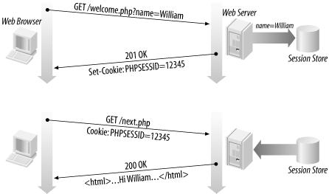
How session are established?
client's browser makes an initial request to the server
server notes client's IP address/browser, stores some local session data, and sends a session ID back to client
client sends that same session ID back to server on future requests
server uses session ID to retrieve the data for the client's session later, like a ticket given at a coat-check room
Once the user has not requested any pages for a while with that session ID, the ID is time out and the session data is discarded by the server. (The default timeout is 24 minutes)

Slide 21
Starting a PHP session
Before you can store user information in your PHP session, you must first start up the session.
Note: The session_start() function must appear BEFORE the <html> tag:
<?php session_start(); ?> <html> <body> … </body> </html>
The code above will register the user's session with the server, allow you to start saving user information, and assign a UID for that user's session.

Slide 22
Storing a Session Variable
Use the PHP $_SESSION variable to store and retrieve session variables.
<?php session_start(); // store session data $_SESSION['views']=1; ?> <html> <body> <?php //retrieve session data echo "Pageviews=". $_SESSION['views']; ?>
//output: Pageviews=1 </body> </html>

Slide 23
Incremental Page-View Counter
<?php session_start();
// isset()checks if "views" has been set. if( isset($_SESSION['views']) ) $_SESSION['views']=$_SESSION['views']+1; else $_SESSION['views']=1;
echo "Views=". $_SESSION['views']; ?>

Slide 24
PHP Session Functions
Function | Description
session_destroy() | Remove all data associated with current session
session_id() | Returns session ID number for current session
session_regenerate_id() | Replace current session ID with a new one. If TRUE is passed, also wipes any data associated with the old one.
session_save_path() | Gets/sets the folder name on the server where session data is stored
session_start() | Begins a number session for the current client; if a session is already in progress, has no effect
session_status() | Returns information about whether session support is enabled or disabled on the current server
session_unset() | Free all session variables currently registered

Slide 25
Case Study: Power Animals
Use session variables to randomly assign the visitor a “power animal” from a list of animals, and also tracks the number of times the user has visited the pages. Once the user has been assigned his/her random animal, that animal should stay associates with that user the rest of the session. Each time the page is reloaded, the site should tell the user how many times he/she visited the page.

Slide 26
Initial PHP Code
<?php
$animals=array("bee", "llama", "octopus", "rabbit", "squirrel", "yak");
session_start();
//check whether the user has ever visited the page before in this session
if (!isset($_SESSION["poweranimal"])||!isset($_SESSION["views"])){
// for new user, set up session data, choose random power animal
$_SESSION["poweranimal"]=$animals[rand(0, count($animals) - 1)];
$_SESSION["views"]=1;
}
else {
$_SESSION["views"]++;
}
?>

Slide 27
HTML Code
<!DOCTYPE html>
<html>
<body>
<h1> Power Animal Finder </h1>
<?php if ($_SESSION["views"]==1) { ?>
<p> Welcome to our site, new visitor! </p>
<?php } else {?>
<p> Welcome back! This is your visit #<?= $_SESSION["views"] ?>.
<?php }?>
<p> Your power animal is the <?= $_SESSION["poweranimal"] ?>!</p>
<p> <img src="<?= $_SESSION["poweranimal"] ?>.png" alt="power animal"/></p>
</body>
</html>

Slide 28
Modified Power Animal
WE can modify our PHP code at the start of the page to check whether the user has submitted the “start over” query parameter, del. If so, we’ll erase the user’s session and start a new one. The code we already wrote will see that the session variables have been wiped out and have no values, so it will start over by creating a new power animal and setting the page view count to 1.

Slide 29
PHP Code
<?php
$animals=array("bee", "llama", "octopus", "rabbit", "squirrel", "yak");
session_start();
if (isset($_GET["del"])){
session_destroy();
session_regenerate_id(TRUE);
session_start();
}
//check whether the user has ever visited the page before in this session
…
?>

Slide 30
HTML Code
…
<form action="animal2.php" method="GET">
<input type="submit" value="Reload"> <br>
<input type="checkbox" name="del"> Start over?
</form>
</body>
</html>

Slide 31
How Sessions are Stored and Managed
When a session is created in PHP, it sends back a cookie to the client with the name of PHPSESSIONID. The client is expected to return this key to the server on future page requests.
The session variables you store into $_SESSION in your php code on the server are not stored on the client. The whole point of sessions are that these variables are maintained on the server.

Slide 32
Continued
The actual implementation in PHP saves sessions into small files on the server’s hard drive, one file per user session.
The location of these file is somewhat system-dependent, but on a Linux server they are often stored into a temp directory with long file names. As the developer of a site, you don’t need to know exactly where the session files are stored nor exactly what data is in each data.
The location of session data might be relevant to you if your site is hosted on a shared server, in which case you might need to change the session data storage directory by altering your server's PHP.ini setting or by calling the session_save_path function.
For large applications that receive lots of traffic, sometimes session data needs to be stored in database or somewhere other than in individual files.

Slide 33
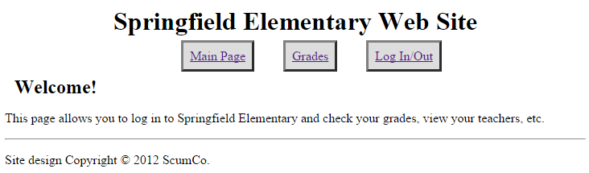
Case Study: User Login System
Write a site where Springfield Elementary students can log in to check their grades.
Implement a user login system that verifies proper user names and passwords.
A student should only be able to view his/her own grades.

Slide 34
Database
Id | Name | Email | password
123 | bart | bart@fox.com | bartman
… | … | … | …
students
Student_id | Course_id | Grade
123 | 10001 | B-
… | … | …
grades
Id | Name | Teacher_id
10001 | Comp Sci 142 | 1234
… | … | …
courses

Slide 35
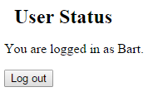

user.php (Login/Out)
<?php session_start(); ?>
# html code
<?php if ( isset($_SESSION["name"] )) { ?>
<h2>User Status</h2>
<p>You are logged in as <?= $_SESSION["name"] ?>.</p>
<form id="logout" action="logout.php" method="post">
<input type="submit" value="Log out" />
<input type="hidden" name="logout" value="true" />
</form>
<?php } else { ?>
<h2>Log in</h2>
<form id="login" action="login.php" method="post">
Name: <input type="text" name="name" />
Password: <input type="password" name="password" />
<input type="submit" value="Log in" />
</form>
<?php } ?>
#html code

Slide 36
login.php
<?php
session_start();
if (isset($_REQUEST["name"]) && isset($_REQUEST["password"])) {
$name = $_REQUEST["name"];
$password = $_REQUEST["password"];
$con=mysqli_connect("pdb9.awardspace.net","1810609_test","lowerUPPER1!", "1810609_test");
$name=$_REQUEST["name"];
$sql="SELECT * FROM students WHERE name = '$name'";
$results=mysqli_query($con, $sql);
$_SESSION["flash"]="Login failed";
if(mysqli_num_rows($results)>0){
$row=mysqli_fetch_array($results);
$correct_password=$row["password"];
if($correct_password===$password){
$_SESSION["name"] = $name; # set to indicate logged in
$_SESSION["flash"]="Login successful"; # flash message appear on homepage
}
}
}
header("Location: index.php"); # redirect to the homepage
?>

Slide 37
PHP header() Function
The header() function sends a raw HTTP header to a client.
It is important to notice that header() must be called before any actual output is sent (In PHP 4 and later, you can use output buffering to solve this problem):
<?php header('Location: http://www.example.com/'); ?>

Slide 38
logout.php
<?php
session_start();
unset($_SESSION["name"]);
$_SESSION["flash"]="Logout successful";
header("Location: index.php");
?>

Slide 39
index.php (Main Page)
<?php session_start();?>
…#html code
<?php
if (isset($_SESSION["flash"])) { print "<p>".$_SESSION["flash"]."</p>"; unset($_SESSION["flash"]);
}
?>
…#html code

Slide 40
grades.php (Grades)
<?php
session_start();
if( !isset($_SESSION["name"] )){
$_SESSION["flash"]="You must log in to see grades!";
header("Location: index.php");
} else{# if user is logged, run sql query and display result
$name = $_SESSION["name"]; $con=mysqli_connect("pdb9.awardspace.net","1810609_test","lowerUPPER1!", "1810609_test");
$sql=“ SELECT courses.name, grades.grades
FROM grades
JOIN courses ON courses.id=grades.course_id
JOIN students ON students.id=grades.student_id
WHERE students.name='$name'";
$results=mysqli_query($con, $sql);
print "<table>";
while($row=mysqli_fetch_array($results)){
print "<tr><td>".$row[name]."</td><td>".$row[grades]."</td><tr>";
}
print "</table>";
}?>

